Slide 1
Diversity and Inclusion: Gender Expansive Terminology
Jordan E. Braxton

Slide 2
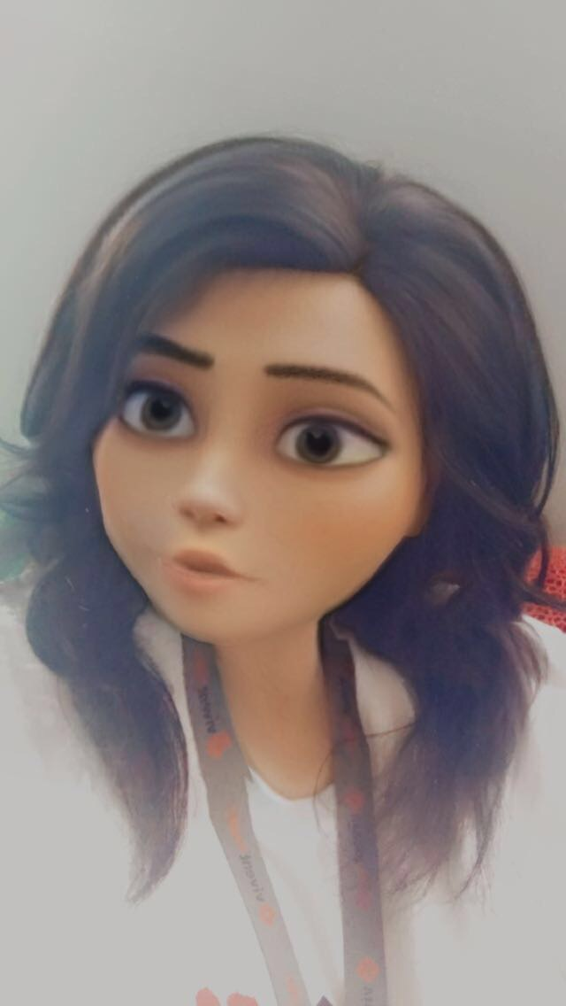
Introduction: Jordan Braxton

Slide 3
Learning Objectives
By the end of the session, participants will be able to:
Identify the difference between Sex and Gender.
Understand that Gender is not binary.
Comprehend LGBTQIA Terminology.
Know the difference between Gender Identity, Gender Expression and Sexual Orientation.
Respect Pronouns and Chosen Name.
Become an Ally for The LGBTQIA Community.

Slide 4
What is Sex?

Slide 5
What is Sex?
Sex refers to a set of biological attributes in humans.
It is primarily associated with physical and physiological features including chromosomes, gene expression, hormone levels and function, and reproductive/sexual anatomy.
Usually, categorized as female or male but is variation in the biological attributes that comprise sex and how those attributes are expressed.
Assigned at birth.

Slide 6
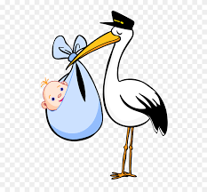
What is Sex?
Sex assigned at birth based on genitalia:
Male:
Assigned Male At Birth
AMAB
Female:
Assigned Female at Birth
AFAB
Intersex
Ambiguous Genitalia

Slide 7
What is Intersex?
A person who is intersex is someone who is biologically neither 100 percent male or female. This may be caused by:
A mixture of male and female genitalia
Ambiguous genitalia
A unique combination of chromosomes
Combinations of chromosomal genotype and sexual phenotype other than XY (male) and XX (female)

Slide 8
What is Intersex?
There are a tremendous number of conditions and levels of intersex. There are over 30 medical terms for specific combinations of Intersex Traits.
Complete Androgen Insensitivity
Klinefelter Syndrome
Turner Syndrome
Vaginal or Penile Agenesis
The term “intersex” encompasses a wide variety of conditions and body types that do not have anything in common except that they are deemed “abnormal” by society.
Every Intersex person is different.

Slide 9
What is Gender?

Slide 10
What is Gender?
Our gender may begin with the assignment of our sex, it doesn’t end there. A person’s gender is the complex interrelationship between three dimensions.
Body
Identity
Expression
The term is also used more broadly to denote a range of identities that do not correspond to established ideas of male and female.

Slide 11
What is Gender?
Body: Our body, our experience, how society genders bodies, and how others interact with us based on our body.
Identity: Our deeply held, internal sense of self as male, female, a blend of both or neither. Who we internally know ourselves to be.
Expression: How we present our gender in the world and how society, culture, community and family perceive, interact with and try to shape our gender.

Slide 12
What is Gender?
Gender is not binary
More than male and female
Gender is on a spectrum
According to various sources there are 28 to 73 different gender identities and gender expressions.

Slide 13
What is Gender?

Slide 14
What is Gender Identity?

Slide 15
What is Gender Identity?
Is one's personal experience of one's own gender. Gender identity can correlate with assigned sex at birth or can differ from it completely.
Gender Conforming
Cisgender
Gender Non-Conforming (GNC)
Agender, Bigender, Transgender, Intersex, Genderqueer, Gender Neutral, Queer, etc.
Is not the same as sexual orientation.

Slide 16
What is Gender?
Cisgender: A person whose sense of personal identity and gender corresponds with their sex assigned at birth.
Relates specifically to gender rather than sexuality.
Can be cisgender and have any sort of sexuality.
Abbreviated as “Cis”
Largely used by those who are sensitive to issues of gender and identity.

Slide 17
What is Gender?
Gender Non-Conforming: A term used to describe people who gender expression is different from conventional expectations of masculinity and femininity.
Gender Non-Binary: A term used by people who experience their gender is falling outside the categories of man and woman.
These terms are not interchangeable.

Slide 18
What is Transgender?
A term for people whose gender and/or gender expression differs from what is typically associated with the sex they were assigned at birth.
Trans – Shorthand term for Transgender
Transgender male (Trans Man, FTM, Transmasculine) – a man who was assigned female at birth but identifies as male. .
Transgender woman (Trans Woman, MTF, Transfeminine) – a woman who was assigned male at birth but identifies as female.

Slide 19
What is Queer?
Is an umbrella term for sexual and gender minorities who are not heterosexual and/or not cisgender.
Also used to describe non-normative identities.
Used as a neutral or positive self-identifier.
Has been reclaimed.
A derogatory name for gay men of a certain age.

Slide 20
What is Genderqueer?
An identity commonly used by people who do not identify or express their gender with the conventional gender distinctions.
Does not follow binary gender norms.
May identify as neither male or female and may see themselves as outside of or in between the binary boxes.

Slide 21
What is Agender?
An umbrella term encompassing many different genders of people who commonly do not have a gender and/or have a gender that they describe as neutral.
Lack of gender.

Slide 22
What is Sexual Orientation?

Slide 23
What is Sexual Orientation?
A term used to refer to a person’s pattern of emotional, romantic, and sexual attraction to people of a particular gender.
Sexuality is an important part of who we are as humans.
Sexuality defines how we see ourselves and how we physically relate to others.

Slide 24
What is Sexual Orientation?
Different types of Sexualities:
Heterosexual - experience sexual, romantic, or emotional attraction to people of the opposite gender. Also described as straight.
Homosexual -experience sexual, romantic, or emotional attraction to people of the same or similar gender. An outdated and offensive term. Gay or Lesbian are the correct descriptions.
Bisexual – experience sexual, romantic, or emotional attraction to people of more than one gender. Referred to as “Bi”

Slide 25
What is Sexual Orientation?
Different types of Sexualities:
Asexual – identity or orientation includes individuals who don’t experience sexual attraction to others of any gender.
There are additional Sexual Orientations that people use to identify themselves other than the ones listed here.
There's no definitive number of sexualities since new words are constantly being conceived and integrated into popular language as the way we talk about sexual orientation evolves.

Slide 26
What is Gender Expression?

Slide 27
What is Gender Expression?
Expression: The way we show our gender to the world around us through clothing, hairstyles and mannerisms.
May not match the person’s biological sex.
Not the same Gender Identity.
A person’s chosen name and pronouns are common ways of gender expression.

Slide 28
Flags

Slide 29
Gender, Sex, or Orientation?
Many people confuse gender, sex, and sexual orientation.
Sex is biological, gender is social, and sexual orientation deals with attraction.
Example: someone can be intersex, transgender, and heterosexual – as these are three independent but related.

Slide 31
Review Time! Questions?

Slide 33
What is a Pronoun?
A pronoun is a word that refers to either the people talking (like I or you) or someone or something that is being talked about (like she, it, them, and this). Gender pronouns (like he and hers) specifically refer to people that you are talking about.

Slide 34
What are some commonly used pronouns?
She, her, hers and he, him, his are the most commonly used pronouns. Some people call these "female/feminine" and "male/masculine" pronouns, but many avoid these labels because, for example, not everyone who uses he feels like a "male" or "masculine."

Slide 35
What is a Gender Pronoun?
A gender pronoun" (GP) is the pronoun that a person chooses to use for themself. For example: If Xena's preferred pronouns are she, her, and hers, you could say "Xena ate her food because she was hungry."

Slide 36
What are Gender-Neutral Pronouns?
Gender-neutral pronouns are words that don't specify whether the subject of the sentence is female or male.
Don’t carry any kind of association with a particular gender.
Also known as Genderless Pronouns

Slide 37
What are Gender-Neutral Pronouns?
They, them, theirs are common gender-neutral pronouns
It can in fact be used in the singular.
(Xena ate their food because they were hungry.)

Slide 38
What are Gender-Neutral Pronouns?
Ze
Ze is pronounced like "zee"
also be spelled zie or xe, and replaces she/he/they.
Hir
Hir is pronounced like "here" and replaces her/hers/him/his/they/theirs.
Xena ate hir food because ze was hungry.

Slide 39
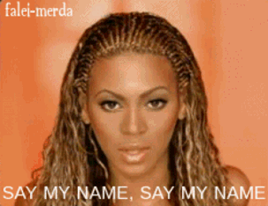
Just my name please!
Some people prefer not to use pronouns at all, using their name as a pronoun instead.
Xena ate Xena's food because Xena was hungry

Slide 40
How do I ask someone what their GP is?

Slide 41
How do I ask someone what their GP is?
The best way to ask for someone's pronouns is to walk up and introduce yourself. Here's an example, “Hey, my name is Jordan, and my pronouns are she/her/hers. What are your pronouns?”
"Which pronouns do you like to hear?" “
Can you remind me which pronouns you like for yourself?"
Once told a person’s GP – BE RESPECTFUL!

Slide 42
What if I make a mistake?

Slide 43
What if I make a mistake?
It's okay! Everyone slips up from time to time.
The best thing to do if you use the wrong pronoun for someone is to say something right away, like "Sorry, I meant she."
If you realize your mistake after the fact, apologize in private and move on.

Slide 44
What if I make a mistake?
A lot of the time it can be tempting to go on and on about how bad you feel that you messed up or how hard it is for you to get it right.
Please, don’t!
It makes the person who was mis-gendered feel awkward and responsible for comforting you, which is absolutely not their job. It is your job to remember people's GPs.

Slide 45
Never, Ever, Ever!
Never, ever refer to a person as “it” or “he-she” (unless they specifically ask you to.)
These are offensive slurs used against trans and gender non-conforming individuals.

Slide 46
Chosen Names

Slide 47
Chosen Name
A chosen name is the use of a name that is different from a person's legal name.
This choice is frequently utilized so that it fits neatly with the individuals' preferred gender.
A chosen name is implicitly different from a birth name or a dead name.
Dead Name - the birth name of a transgender person who has changed their name as part of their gender transition.

Slide 48
Chosen Name
Some people have a name that is different from their legal or name assigned at birth.
Being able to use a chosen name will reduce the likelihood of a trans or trans expansive person from being misgendered or triggered.

Slide 49
Chosen Name
To be triggered is to have an intense emotional or physical reaction.
This reminder can cause a person to feel overwhelming sadness, anxiety, or panic.
It may also cause someone to have flashbacks. A flashback is a vivid, often negative memory that may appear without warning.

Slide 50
Why is it important to respect pronouns and chosen name?
You can't always know what someone’s pronoun or chosen name are by looking at them.
Asking and correctly using someone's pronoun and name is one of the most basic ways to show your respect for their gender identity.
When someone is referred to with the wrong pronoun, it can make them feel disrespected, invalidated, dismissed, alienated, or dysphoric (or, often, all of the above.)
It is a privilege to not have to worry about which pronoun someone is going to use for you based on how they perceive your gender. If you have this privilege, yet fail to respect someone else's gender identity, it is not only disrespectful and hurtful, but also Oppressive.

Slide 51
What is an Ally?

Slide 52
What is an Ally?
Allyship is a lifelong process of building relationships based on trust, consistency, and accountability with marginalized individuals and/or groups of people.

Slide 53
What is an Ally?
Marginalized: People or communities that are targeted by oppression, including but not limited to: people of color (POC), Muslims, immigrants, refugees, LGBTQIA people, women, and people with disabilities.

Slide 54
What is an Ally?
Someone who advocates and supports a community other than their own.
Are not part of the communities they serve
Shows they are an Ally through action.
You can’t anoint yourself as an Ally. Allies have the ability to use their voice to promote active change in any community.
The best allies are willing to make mistakes and keep trying.
Allyship is a journey
Being an ally is hard work.

Slide 55
To Be An Ally is to:
Take on the struggle as your own
Transfer the benefit of your privilege to those who lack it.
Amplify this voice of the oppressed before your own.
Acknowledge that even though you feel pain, the conversation is not about you.
Stand up even when you feel scared.
Own your mistakes and de-center yourself.
Understand your education is up to you and no one else.

Slide 56
Ways to be a better Ally.
Listen: to what marginalized people are saying – face-to-face, on your social media feeds, or in the articles you read. It’s not about you, your feelings or opinions; it’s about hearing theirs.
Get educated: Seek out books, articles, films, etc. about the history and current issues facing marginalized communities and attend formal anti-oppression trainings.
Get Involved: Join local groups working for social justice. Subscribe to their e-mail lists, follow them on social media and show up to support their work.

Slide 57
Ways to be a better Ally.
Show Up: When someone from a marginalized community invites you to an event, go – be there to listen, learn and show your support.
Speak Up: When a friend, family member, co-worker or stranger says something hateful or ignorant, call them out on it. Silence allows oppression to continue.
Intervene: When someone is being targeted – physically or verbally – intervene only with their permission. Focus on supporting them rather than engaging the aggressor.

Slide 58
Ways to be a better Ally.
Welcome Discomfort: When you encounter something that makes you uncomfortable, don’t dismiss it. Sit with it, ask yourself ‘why?’ and welcome it as an opportunity to grow.
Learn From Your Mistakes: You will make mistakes. When someone calls you out, don’t get defensive. Listen, apologize, and change your behavior going forward.
Stay Engaged: Even when the work gets difficult, stay engaged. Oppression is constant, and marginalized people do not have the privilege of “turning off”.

Slide 59
Summary
Sex is biological, Gender is social, and Sexual Orientation deals with attraction.
Gender is not binary
Sex and Gender are not the same thing.
Gender Identity, Gender Expression, and Sexual Orientation are independent of each other.
Asking and correctly using someone's pronoun or chosen name is one of the most basic ways to show your respect for them.
Allyship is a journey.

Slide 60
Conclusion
Only when people feel totally authentic and connected with their organizations can they achieve their full potential at work. Gender Expansive employees are no exception.
Crafting a corporate legacy—one in which human dignity is prioritized and doing the right thing by employees is regarded as fundamental to its success.

Slide 61
“Education is our greatest weapon in this fight against intolerance”
-Nelson Mandela

Slide 62
Review Time! Questions?

Slide 63
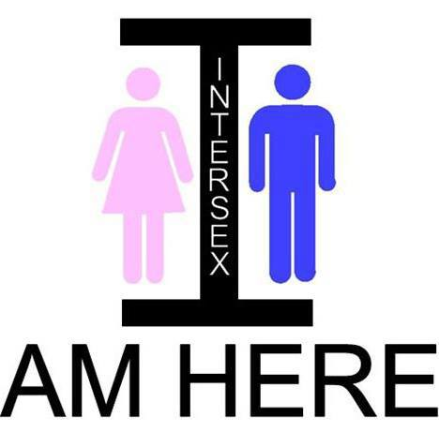
My Journey

