Slide 1
Welcoming & Affirming LGBTQ Older Adults
Presented by
Sarah Lovegreen
&
Sherrill Wayland

Slide 2
U.S. Older Adult Population Growth: 2000-2030
35 million to 75 million = 20% of the U.S. population
55+ LGBT
in 2030:
7 million
55+ LGBT
in 2015:
3 million
60+ LGBT
in 2030:
1.2 million
60+ I/DD
in 2000:
640,000+
Notes:
The % of the U.S. population over 65 will double by 2030
Just as the aging population is growing so is the population of older LGBT people and people with Intellectual and Developmental Disabilities. At the intersections we also know that the population of older people with IDD and LGBT orientation/identity will also increase.

Slide 3
Do you know of older LGBTQ+ members in your congregation?
Notes:
How many of you know you have older LGBT members in your congregation?
For those that raised your hand – how do you know they identify as LGBT? Have they come out to you? What are ways you have created welcoming spaces?
If we asked the reverse of this question to LGBT aging organizations – we might have a few hands go up but by and large talking about the intersections of aging, LGBT and disability has received little attention.

Slide 4
Spiritual Themes in the Lives of LGBT Elders
LGBT experiences
Spiritual Themes
Shrinking Social Supports and Networks
History of Trauma
Discrimination & Harassment
Rejection by Family of Origin
Religious Discrimination and Alienation
Legal and Financial
Love & Belonging
Forgiveness & Reconciliation
Trust
Hope
Meaning
Gratitude
Identity
https://www.lgbtagingcenter.org/resources/resource.cfm?r=896

Slide 5
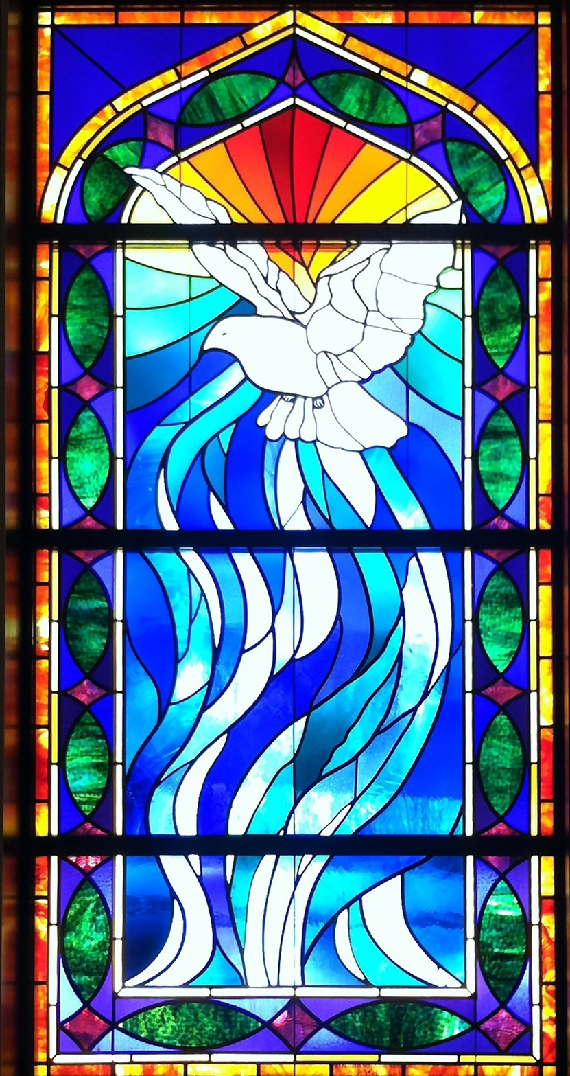
Notes:
The Church and Stained glass windows have a long history, often used to help tell religious stories. Let’s consider for a moment that the individual stained glass pieces represent each person who sets foot in the church and consider the church a part of their life, home, community and gives so much meaning to their life. For so many LGBT people faith and the church continues to be central to their lives. Yet there are some who have felt alienation from their faith and church home.

Slide 6
Notes:
Sitting in the church and hearing the pastor speak about you as abomination.

Slide 7
Notes:
Being told by the church that they will not perform a funeral for your gay son.

Slide 8
Notes:
Having your church tell you that you are sick and can be cured if you just have faith. These are the stories and real experiences of so many LGBT people who have felt lost and abandoned by a faith they once held so dear. For each LGBT person and family that leaves the church – they also take a part of the stained glass with them. Many carry these memories throughout their lives and look for the opportunity to cornicle their faith.

Slide 9
Notes:
It may be years of spiritual searching but the faith can remain strong. And when they find Open and Affirming Churches – they can return to their communities at a time when they need it most and start to rebuild and complete their story through the stained glass.

Slide 10
Notes:
The gay man in hospice who was befriended by a Chaplin. Who sat with him and heard for the first time of his struggles with religion and being gay. Through their time together the man was able to reconcile his faith and I have always hoped that this provided him with peace during his final days.

Slide 11
Notes:
My friend who in her 80’s shared that her pastor, saved her from loosing Christianity forever. Her pastors became a part of my friend and wife’s support circle as we supported them through the progression of dementia and hospice and sat with me their bedsides as they left this earthly journey – two weeks a part.
Open and Affirming Churches can play a central role in the lives of LGBT elders who want to reconcile their faith and heal the wonds they have carried for many years.

Slide 12
Spirituality and End of Life Resources
Spirituality & End of Life for LGBT Elders
This fact sheet provides an understanding of how a history of trauma may impact end of life spiritual support for LGBT elders and suggestions for professional caregivers.
Spiritual Themes in the Lives of LGBT Elders
This fact sheet explores the spiritual lives of LGBT elders through spiritual themes rooted in a person's search for meaning and purpose in life.
Spiritual Care & Non-Religious Elders: Individualized Spiritual Care
This fact sheets discusses ways chaplains can provide spiritual support and resources to non-religious LGBT older adults.
www.lgbtagingcenter.org

Slide 14
Types of Dementia
DEMENTIA:
Alzheimer’s
Vascular
Lewy body
Frontotemporal
An umbrella term for loss of memory and other thinking abilities severe enough to interfere with daily life
Other, including Huntington’s
Mixed dementia: dementia from more than one cause
Notes:
Just to make sure we’re all on the same page with some important definitions….our mission references Alzheimer’s AND dementia. Let me tell you a bit about dementia and Alzheimer’s.
Dementia is a general term for loss of memory, thinking, language, problem-solving and other abilities that are severe enough to interfere with daily life. Alzheimer's is the most common cause of dementia.
Dementia is not a single disease; it’s an overall term — like heart disease — that covers a wide range of specific medical conditions, including Alzheimer’s disease. Disorders grouped under the general term “dementia” are caused by abnormal brain changes. These changes trigger a decline in thinking skills, also known as cognitive abilities, severe enough to impair daily life and independent function. They also affect behavior, feelings and relationships.
Alzheimer's disease accounts for 60-80% of cases. Vascular dementia, which occurs because of microscopic bleeding and blood vessel blockage in the brain, is the second most common cause of dementia. Those who experience the brain changes of multiple types of dementia simultaneously have mixed dementia. There are many other conditions that can cause symptoms of dementia, including some that are reversible, such as thyroid problems and vitamin deficiencies.

Slide 15
What is Alzheimer’s?
Alzheimer's is a brain disease that causes problems with memory, thinking and behavior. Symptoms eventually grow severe enough to interfere with daily tasks.
Alzheimer's is a progressive disease, where symptoms gradually worsen over a number of years.
In the early stages, memory loss is mild. But as the disease progresses, individuals will need around-the-clock care. The disease is ultimately fatal.
Notes:
Alzheimer's is the most common cause of dementia. It is not a normal part of aging.
The greatest known risk factor for Alzheimer’s is increasing age, and the majority of people with Alzheimer's are 65 and older. Alzheimer’s disease is considered to be younger-onset Alzheimer’s if it affects a person under 65. Younger-onset can also be referred to as early-onset Alzheimer’s. People with younger-onset Alzheimer’s can be in the early, middle or late stage of the disease.
Alzheimer's worsens over time. Alzheimer's is a progressive disease, where dementia symptoms gradually worsen over a number of years. In its early stages, memory loss is mild, but with late-stage Alzheimer's, individuals lose the ability to carry on a conversation and respond to their environment. On average, a person with Alzheimer's lives 4 to 8 years after diagnosis but can live as long as 20 years, depending on other factors.
Often dementia will start out slowly and gradually get worse. If you or someone you know is experiencing memory difficulties or other changes in thinking skills, don't ignore them ~ even if the symptoms are mild. See a doctor soon to determine the cause. There are many benefits to receiving an early and accurate diagnosis, including an opportunity to plan for the future, access support services and explore treatment options.

Slide 16
LGBTQ+ Americans and Alzheimer's Disease
LGBTQ+ older adults living with dementia are significantly more likely to live alone, not be partnered or married, not have children, and not have a caregiver.
They face unique challenges in accessing support:
40% report that their support networks have become smaller over time.
Up to 30% experience lower rates of access to care.

Slide 17
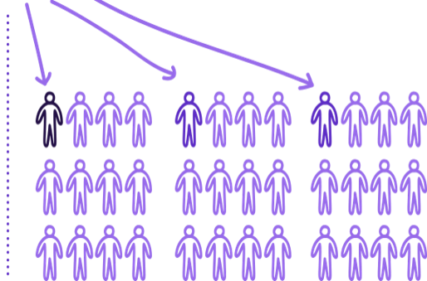
Care & Support
Program Reach with Volunteers
Exponential increase in number of people reached.
Education & Awareness Programs
Support Groups
Early Stage
24/7 Helpline & Care Consultations

Slide 18
Notes:
Faith organizations play an important role in reaching people impacted by ALZ an other dementia.

Slide 19
Purple Sundays
Purple Sunday is designed to educate members of the faith community about Alzheimer’s and other dementias.
Attendees will learn about the impact of Alzheimer’s disease in our community, how to recognize the signs of Alzheimer’s, the importance of early detection, and how to access care and support resources offered by the Association.

Slide 20
Purple Sunday:
Devote one sermon or bible study to issues surrounding faith, aging and dementia
Wear purple dresses, hats, ties, shirts (take photos)
Host a Prayer with a Purpose circle for people affected by Alzheimer’s and other dementia
Consider hosting an Alzheimer’s Association program

Slide 21
Faith Outreach Ambassadors
Raise awareness within faith community
Connect to Alzheimer’s Association resources
Offer short presentations to raise awareness
Share information
24/7 Helpline (800-272-3900)
Education Program
Support Groups
Get involved in The Longest Day or Walk to End Alzheimer’s

Slide 22
The Alzheimer’s Association provides care and support to those affected.
Free 24/7 Helpline: 800.272.3900
Staffed by master’s-level clinicians and specialists
Provides confidential support and information in over 200 languages
Resource-rich website: alz.org®
Often the first stop for individuals after receiving a diagnosis
Includes sections for those living with the disease, caregivers and health care professionals
ALZConnected®: alz.org/alzconnected
Free online community designed for people living with dementia and their caregivers
Education and support: alz.org/CRF
For caregivers and individuals living with Alzheimer's or other dementia
Offered in-person, virtually and online
Alzheimer’s Association & AARP Community Resource Finder: alz.org/CRF
Comprehensive database of local dementia and aging-related resources
Local chapters nationwide: alz.org/findus
Programs and services in communities across the country

Slide 23
Stay In Touch
Sherrill Wayland
SAGE, Senior Director Special Initiatives and Partnerships
swayland@sageusa.org
www.sageusa.org
www.lgbtagingcenter.org
Sarah Lovegreen
Alzheimer’s Association, Greater Missouri
Vice President of Programs
sllovegreen@alz.org
www.alz.org

