Slide 1
A Lesson in Language LGBTQ+ Terminology
Together Again
March 2023

Slide 2
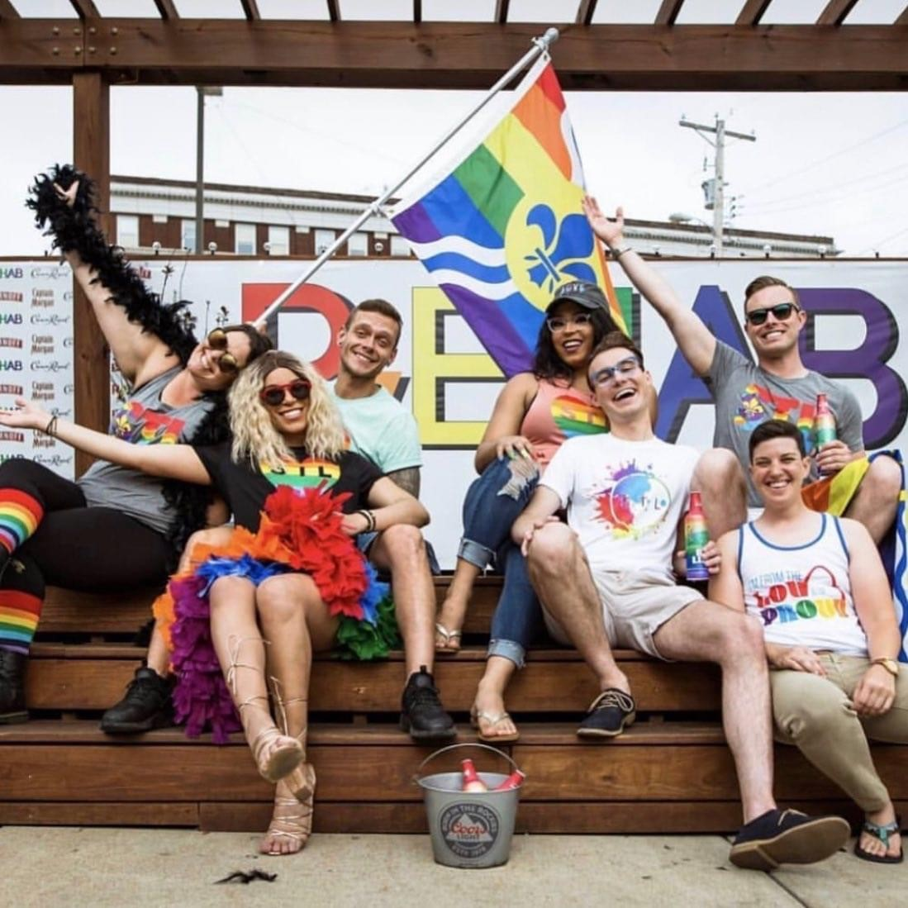
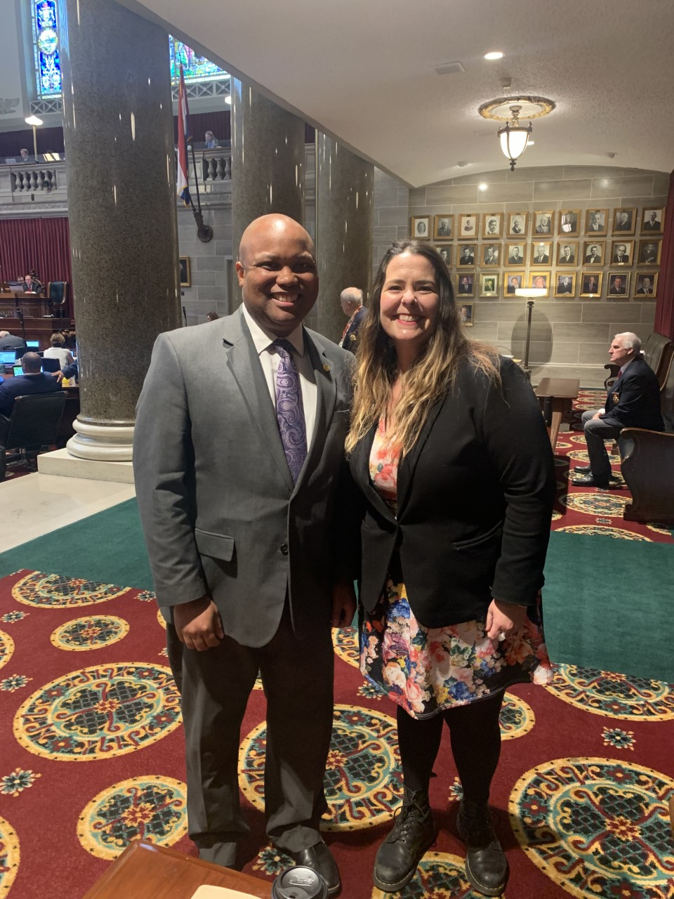
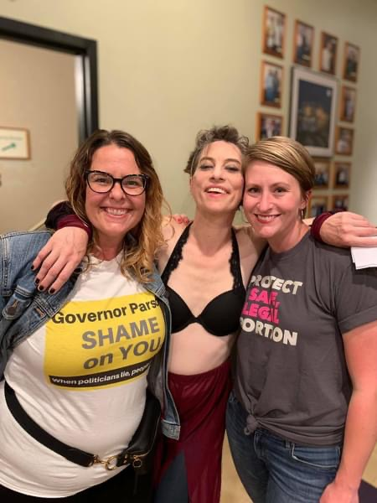
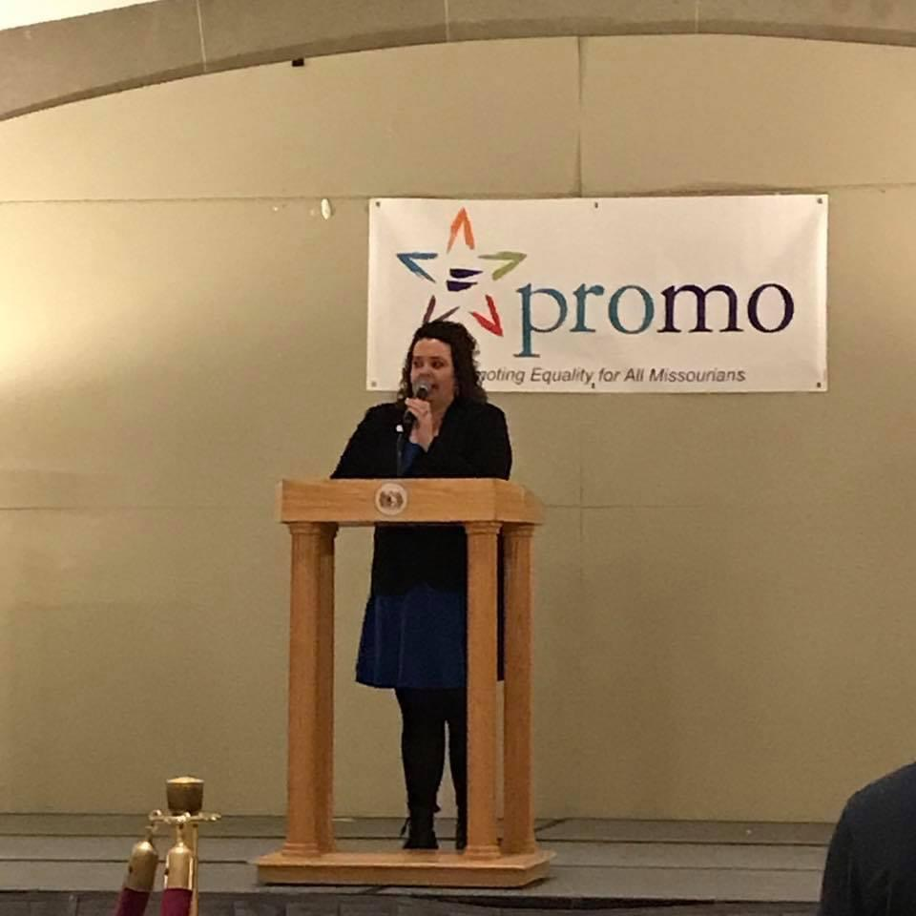
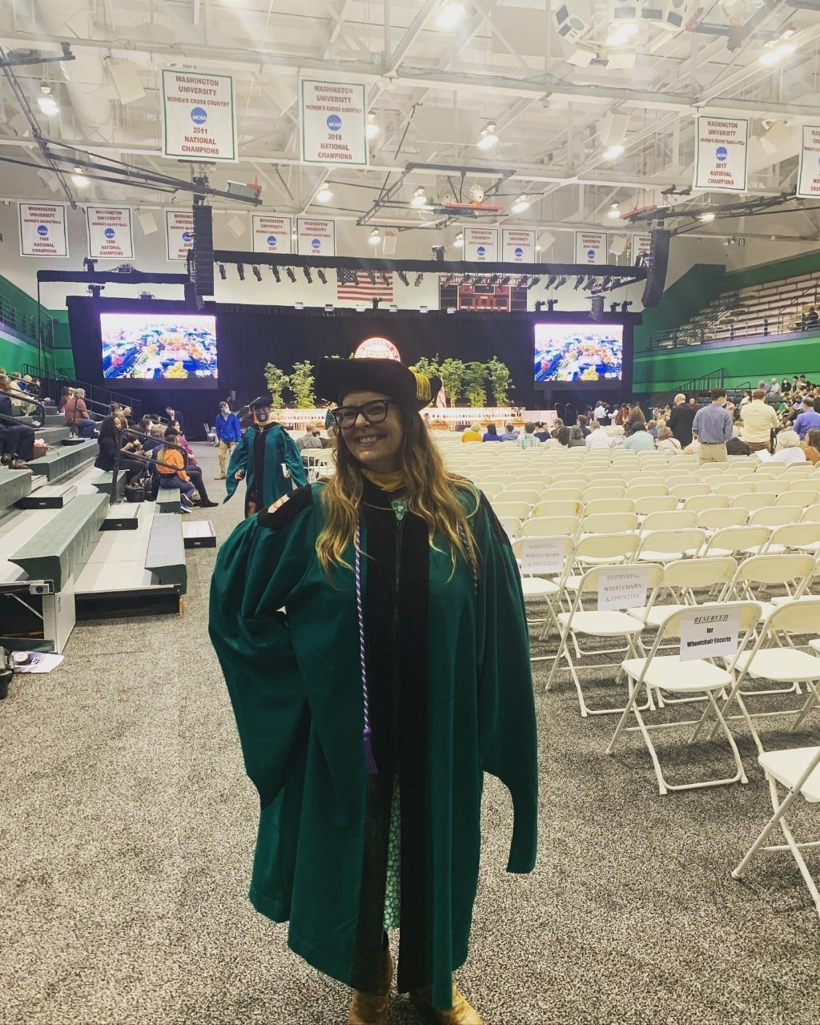
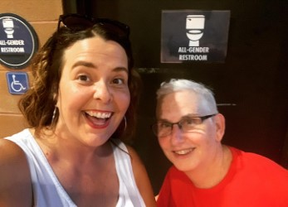

Slide 3
Sitting in Discomfort and Treating Shock
Notice what is happening in your body
What are you feeling?
Fight/Flight/Freeze
Any other emotions?
What do you need in the moment?
Breathe
Essential Oils
Ice/Heat
What next?
Engage in dialogue
Put it on a shelf
Process and Use it…eventually

Slide 4
Community Norms
Community Agreements for Community Building and Conversation
Anchor in curiosity
Be present
Make space, take space
Practice power analysis (who am I to others in the room?)
“I” statements
“Assume positive intent, affirm negative impact.”
Notes:
How to have a challenging conversation. How to sit in the discomfort here with our peers and out in the world. Engaging in dialogue that calls people-in to conversation.
This often is useful in naming that we all have the best of intentions. AND, even then, we impact those around us. How do we shift the focus from “but I meant well” to “oh, a thing happened. How can we move through that?”

Slide 5
Agenda- Saturday, March 4th, 2023 1:30-2:30 CST
1:30-1:35 Stroll in and attune to space
1:35-1:45 Introduction of Speaker, Space, and Topic
1:45-2:15 A Lesson in Language: LGBTQ Terminology Tips and Tools
2:15-2:30 Conversation and Questions

Slide 6
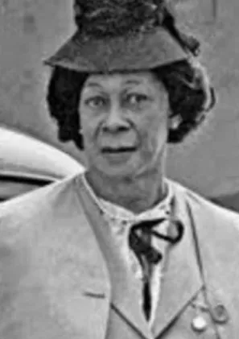
Born in Waddy, Kentucky in 1886, Lucy Hicks Anderson insisted on wearing dresses to school. While Anderson was a child her concerned mother took her to a doctor who suggested that she allow her child to live as a female. By age 15, she changed her name to Lucy and left home. Lucy Lawson married Clarence Hicks in 1920 and divorced him in 1929. Working as a domestic, she saved her money and eventually owned and operated a brothel in Oxnard, CA. In 1944, Lucy Hicks married Reuben Anderson. But in 1945, when an outbreak of venereal disease in Oxnard was said to have originated from Hicks’s establishment, the employees were ordered to undergo a medical physical examination where it was revealed that Lucy was assigned male at birth. Upon discovery, the Ventura County District Attorney voided the marriage and arrested Lucy for perjury, justifying the charge by saying she had signed the marriage license stating there were “no legal objections to the marriage.” Both Lucy Hicks Anderson and her husband were tried by the federal government. During her perjury trial Lucy Hicks Anderson insisted that a person could appear to be of one sex but actually belong to the other, saying, “I defy any doctor in the world to prove that I am not a woman.” She told reporters, “I have lived, dressed, acted just what I am, a woman.” She was placed on ten years probation as an alternative to prison. However, her troubles were not over. When the government concluded that Lucy had been illegally receiving Anderson’s allotment checks as the wife of a member of the U.S. Army, the couple was tried and convicted of fraud. After her release from prison, Lucy Hicks Anderson was banned from moving back to Oxnard. She relocated to Los Angeles where she lived until her death in 1954.
Lucy Hicks Anderson
(Legacyprojectchicago, 2022)

Slide 7
Notes:
Brave Space for sharing
Some of you have never had these conversations in a large group.
Honor your journey.
For Queer family- this is your opportunity to learn the incremental ways we teach people about who we are. About target audience and messaging.
We are starting at the beginning. We make no assumptions.
Take care of yourselves on this journey.

Slide 8
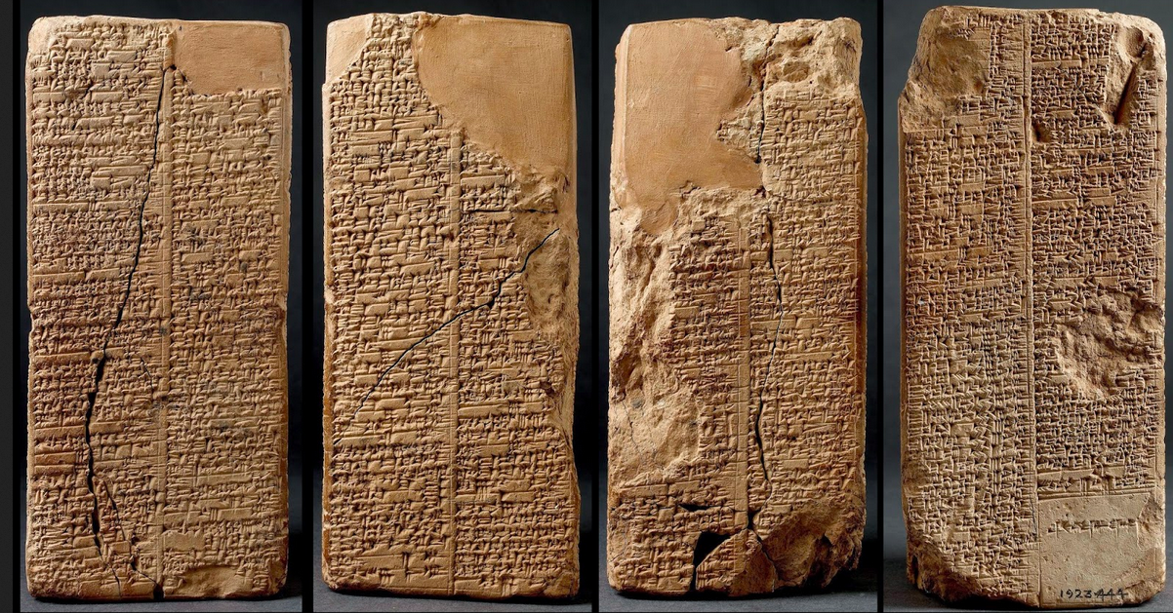
Notes:
Language. Ever evolving. Tablets sure are different.
Words are used to empower. Words are used to oppress. Words are changing all the time.
Language is socially constructed, and we made it up. So why can’t we make up more along the way?
What does it mean to sit in the discomfort when you hear something that challenges you? How do people hear information? When does our discomfort zone become too uncomfortable and we stop listening. We want our audience to learn. To grow as practitioners and healers. As allies to the queer community. If they stop listening, they learn nothing about our people. Know your audience. Know your role. Incremental change. Ex. Poplar Bluff Health Department Trans 101 and HIV Intake Form Training

Slide 9
Intersectional Lasagna
Notes:
This is a theory that I started teaching in 2015. I was a adjunct instructor at UMSL. I was teaching Gender, Sexuality, and Aging. At the time, I was trying to explain what intersectionality is and how we use it in practice. I developed this tool about how to explain intersectionality to people who have no understanding to those with an advanced understanding. To me being able to conceptualize intersectionality is how we start to see people. To really and truly see the person who is in front of us. Whether it is a client, a supervisor, or a policy maker, this tool allows us as practitioners to gain an awareness into who is in front of us. What story did they come here with today. How might I ask open-ended questions to encourage dialogue to gain common ground and start the system change process.

Slide 10
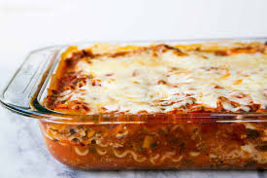
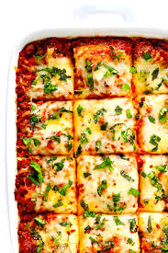
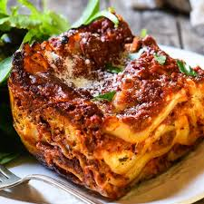
Notes:
There are so many types of lasagna
All the ingredients represent our identities.
Outside forces- heat, cold, dropping it on the ground, etc represent that which we can control systems of oppression
When working with someone we may only see the top layer. We may not know the many layers of identities that lay under the surface. It is important to take into consideration those parts of the identity that may be more challenging to share.
Ex. GiGi

Slide 12
6
Notes:
-Maybe some of you have never really given much thought to your own sexual orientation, gender, gender identity, and/or gender expression. Maybe when you were a little bity baby- someone marked your birth certificate with the sex that matched your genitalia. Maybe you were not given a choice and maybe your sex matches your gender exactly. Maybe your own definition of your gender is more fluid that the traditional binary will allow. Maybe your gender and your sex marker assigned at birth do not match at all. This is the experience of people who identify as transgender.

Slide 13
Sex & Gender

Slide 14
Definition: SEX
The term sex refers to biological differences among male, female, and intersex people (hormones, secondary sex characteristics, reproductive anatomy) that can be altered over time through the use of hormones and surgical interventions.
7

Slide 15
XO
XXX
XXY
XYY
Intersex
Male
Female

Slide 16
Definition: INTERSEX
Intersex is a general term used for a variety of conditions in which a person is born with a reproductive or sexual anatomy that doesn’t seem to fit the typical definitions of female or male.
Intersex is not an option when assigning sex on a US birth certificate.
8
Notes:
Ex: A person with male genitalia and female hormones.
Washington state will be offering a 3rd option in 2018

Slide 17
Definition: GENDER
Gender is a multidimensional construct with psychological, social, and behavioral dimensions including gender identity and gender expression. Gender may be reported in terms of a person’s felt, desired, or intended identity and expression, as well as how an individual believes he or she is perceived by others
9
Notes:
-Important to understand that sex and gender are two different constructs. Also, one’s gender does not determine one’s sexual orientation. People who are transgender have a sexual orientation. You and I have a sexual orientation. You and I have gender. My gender identify does not directly correlate to my sexual orientation. These two are separate. I identify as a woman and my sexual orientation is lesbian. My friend who is a transman’s gender identity is male and his sexual orientation is gay. These two are separate.

Slide 18
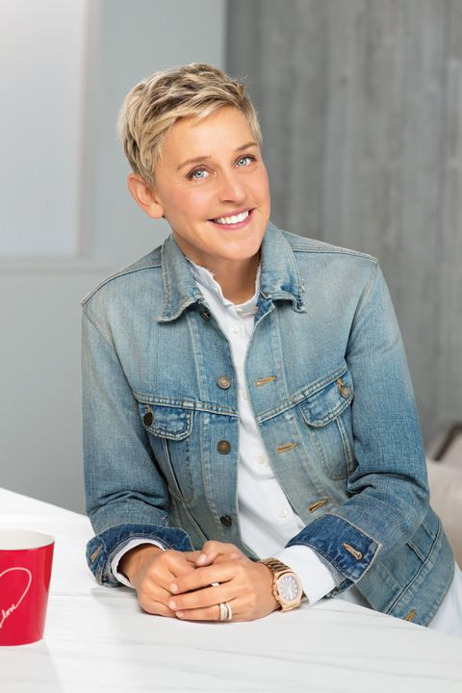
Definitions
Gender identity - the gender you feel you are on the inside
Gender expression - how we show our identity to others
Gender role -society’s concept of how men or women should behave
Figure 1: Ellen Degeneres
9

Slide 19
Definition: TRANSGENDER
Transgender: Gender identity, expression and/or behavior is different from those behaviors typically associated with their assigned sex at birth.
***(Note: Transgender is correctly used as an adjective, not a noun, thus "transgender people" is appropriate but "transgenders" is often viewed as disrespectful.)

Slide 20
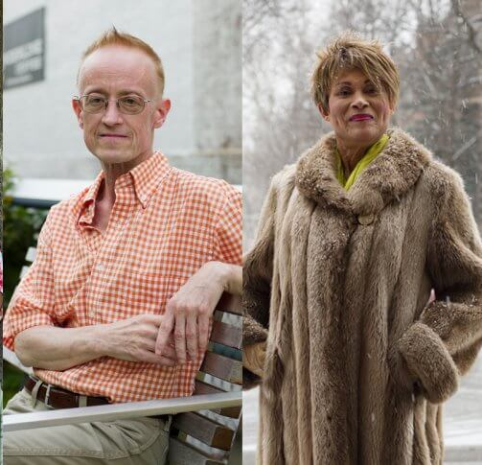
Definition: TRANSGENDER
Transgender Man: assigned female at birth, identifies as male
Transgender Woman: assigned male at birth, identifies as female

Slide 21
TRANSGENDER: Umbrella term (adj.) for people whose gender identity and/or gender expression differs from the sex assigned at birth and/or societal expectations thereof.
CISGENDER: “Cis-” = “same as” Term for people whose gender identity is the same as the sex assigned at birth.
TRANS UMBRELLA
trans man - trans woman - agender - gender fluid - gender expansive - trans masculine
May or may not include: -drag performers -Intersex -Two-Spirit
- genderqueer - gender non binary - cross dresser/
transvestite - bigender
- gender non conforming - trans feminine
-ETC

Slide 22
Definition: CIS-GENDER
Cisgender is a complementary concept to “transgender” and is used instead of “non-transgender”
Cisgender refers to individuals whose gender identity matches their sex assigned at birth
10

Slide 23
11
Notes:
-Gender is a spectrum. Not the binary. Each of us falls somewhere along the spectrum. Although maybe you have never thought about gender outside of the traditional binary of male and female.
- Discuss the graphic.
-Please take a moment to think about how your biological sex marker assigned at birth matches how you identify and express your gender.
-Now look out across the room to a perfect stranger. How comfortable would you be in sharing how your assigned sex matches how you feel on the inside and how you express yourself on the outside? Or how people perceive you to be? If you are saying to yourself…no big deal…I could tell that stranger about who I am, then you are experiencing privilege. Most cig-gender people have this privilege and it goes with them to the dr, the hospitals, everywhere. For people who identify as transgender, this is not their experience. They do not have the same privilege.
Ex: how I was going to present this part of the conversation. Recognizing my own privilege.

Slide 24
Sexual Orientation

Slide 25
Definition: SEXUAL ORIENTATION
Your primary physical, romantic, and/or emotional attraction to other people
7

Slide 26
Sexual Orientations
Straight or Heterosexual
Lesbian
Gay
Bisexual
...
Sexual Preference Homosexual Queer
Sexual Preference Homosexual
Sexual Preference Homosexual

Slide 28
Who has a Sexual Orientation & Gender Identity?
Notes:
Ask the participants: Take a moment and about this question, “Who has a Sexual Orientation & Gender Identity? (Give a couple of seconds of silence)
We all have a sexual orientation and gender identity. But the majority of may have never thought about this question because your sexual orientation and gender/gender identity matches societal norms.
For people who identify as Lesbian, Gay, Bisexual or Transgender (LGBT), this a question thought about a great deal and often entails a great deal of internal struggle to accept ones true self against societal expectations of heterosexuality or assigned birth sex of male or female.

Slide 29
Pronouns: Become Familiar & Practice

Slide 30
Note on Pronouns
Don’t know? Ask?
We all mistakes with pronouns, but try your best
Don’t have to “get” what being transgender is to use right pronouns (same with chosen name)

Slide 31
Gender Neutral Language in Everyday Conversation

Slide 32
1. CHANGE your language
Use non-gendered language; say, “… your partner, spouse, they, he or she…”
Allow the opportunity to select their own pronouns
Mirror the language people use for themselves, their partners and their body parts.
2. SHOW your openness
Try not to react if someone comes out to you
Ensure confidentiality
Inclusive policy
Examine/update intake forms to be LGBT-inclusive
Representative publications/ information in your waiting room.

Slide 33
Non-inclusive Assumptions
Sex Male or Female
Gender Identity Man, Woman
Sexual Orientation Attracted to Women, Men, or anyone
Intersex
Transgender Identities
Lesbian, Gay, Bisexual
Notes:
Notes:
Sex: What about Intersex?
Genderidentity: What if the person doesn’t feel like they fit the mold portrayed in media or meet society’s expectations or feel comfortable with their body? Can you assume by clothing? Job? Haircut? Hobbies? Voice? Actions? Relationship make-up?
Sexual orientation:
are all people born with male bodies attracted to women? Are all people born with female bodies attracted to men? Are people only attracted to masculine men or feminine women? What about feminine men and masculine women?

Slide 35
An ally’s best tool: A Journey Story

