Slide 1
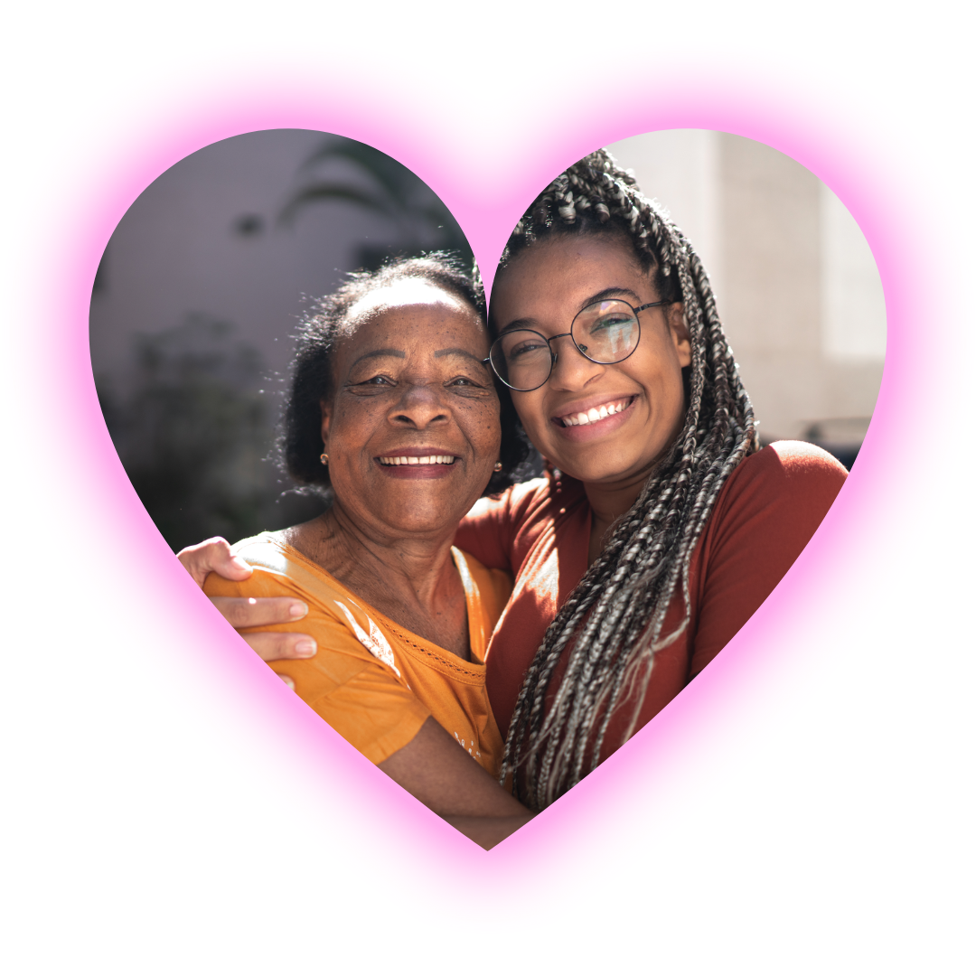
Supporting Your LGBTQ+ Grandchild

Slide 2
Notes:
LIZ:
It’s possible you’re here because you have a grandchild who came out as lesbian, gay, bisexual, transgender, nonbinary, queer, or questioning – that’s what LGBTQ stands for. We’re here to provide some information and hopefully give you some answers to some big questions.
Grandparents play an important role in the lives of their grandchildren, serving as a soft spot to land during difficult times. Yet, when a grandchild comes out as LGBTQ+, grandparents might be among the last to know.
This isn’t because that relationship is less important, however, but sometimes because an LGBTQ+ young person might be fearful of losing that close relationship and unconditional love, which means so much to them. No matter where you are starting on this coming-out journey with your grandchild, your relationship can grow even closer as you work to embrace your grandchild’s identity fully, and continue to offer unconditional love and support.

Slide 3
Let’s start with some basics…
What is gender identity?
What is gender expression?
What is sexual orientation?
How are they all related?
Notes:
SHERRILL:
When a baby is born—and thanks to modern technology, often long before—a doctor takes a quick look at its visible sex organs, and assigns that baby a sex. From this assigned sex, we assume the baby’s gender—either boy or girl.

Slide 4
Gender Identity
Notes:
SHERRILL:
For the vast majority of people, their gender identity—that is, their internal sense
of being male, female, some of both, or neither—matches their assigned sex. Those people are called cisgender.
For others, their gender identity does not correspond with that assignment; those individuals often refer to themselves as transgender or, for those who don’t fit into the man-woman binary, as nonbinary.
Other terms you might hear for people who feel that their internal sense of self is at odds with their biological sex include things like genderqueer or gender nonconforming. For transgender and nonbinary people, there is a disconnect between how others perceive them based on outside physical characteristics and their internal sense of themselves.

Slide 5
Gender Expression
Notes:
SHERRILL:
Whatever our gender identity might be, everyone—cisgender, transgender, and nonbinary people alike—communicates their gender identity in a manner that is comfortable for them through clothing, hairstyles, mannerisms, or other outward presentations or behaviors. That is called gender expression.

Slide 6
Sexual Orientation
Notes:
SHERRILL:
As a person gets older, they will potentially become aware of feelings of attraction—physical, emotional, psychological, intellectual, spiritual—towards other people. These attractions describe their sexual orientation.
It is important to note that sexual orientation is separate and distinct from gender identity and gender expression.

Slide 7
Gender Identity
Gender Expression
Sexual Orientation
Notes:
SHERRILL:
Gender identity.
Gender expression.
Sexual orientation.
Each one separate, each one distinct, and each of us has all of them!
Now that we’ve explained the basics, let’s talk about some of the most frequently
asked questions we get from grandparents.

Slide 8
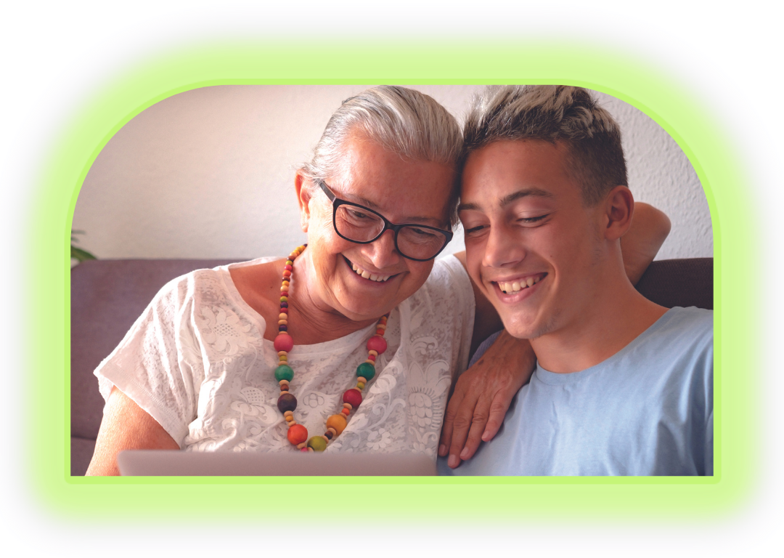
My grandchild is too young to date. How can they know what their sexual orientation is?
Kids are coming out earlier than ever
Sexual or romantic experiences are not necessary to understand one’s attractions to other people
Trust kids—they know who they are
Notes:
LIZ:
Kids are starting to come out earlier than ever as gay, bisexual, pansexual, and more. It’s easy to think, “There’s no way they can know—they haven’t had sex or been on
a date yet!” And yet...they know.
Sexual or romantic experiences are not necessary to understand one’s attractions to other people; think back to your own first crushes in school. Additionally, because kids are seeing themselves positively reflected in tv shows, movies, books, and elsewhere, that positive reinforcement lets them know that there is nothing wrong with them for having those feelings, and that encourages them to live authentically, when they feel safe and supported to do so.
Kids know who they are—as grandparents, your job is to lead with love, listen, and support them, and then find support for yourself if acceptance is in any way a struggle.

Slide 9
How can my grandchild know they are transgender at such an early age?
For most people who are transgender or nonbinary this sense of gender identity happens early in their development
Kids need to explore, gender is often one of those explorations—it is good to give them space to do that
Trust kids—they know who they are
Notes:
SHERRILL:
Think back to when you first knew yourself to be the gender you are. It is likely that it was so early in your development that you may not even remember it. And because what you saw in the mirror matched how you felt inside, you might never have had any reason to think about it—until now. For most people who are transgender or nonbinary this sense of gender identity also happens early in their development.
However, it becomes more top of mind because their outward appearance and how people perceive them doesn’t necessarily match their inner sense of themselves. For some kids, this happens as early as toddlerhood. For others, later.
Many kids like to play and explore with gender roles—whether that’s playing dress-up or playing house, cutting their hair, or trying out a new name. It’s good to give kids time to be creative and try new things.
Regardless, trust kids and follow their lead: They know who they are, and we can support and love them as they go through this process.

Slide 10
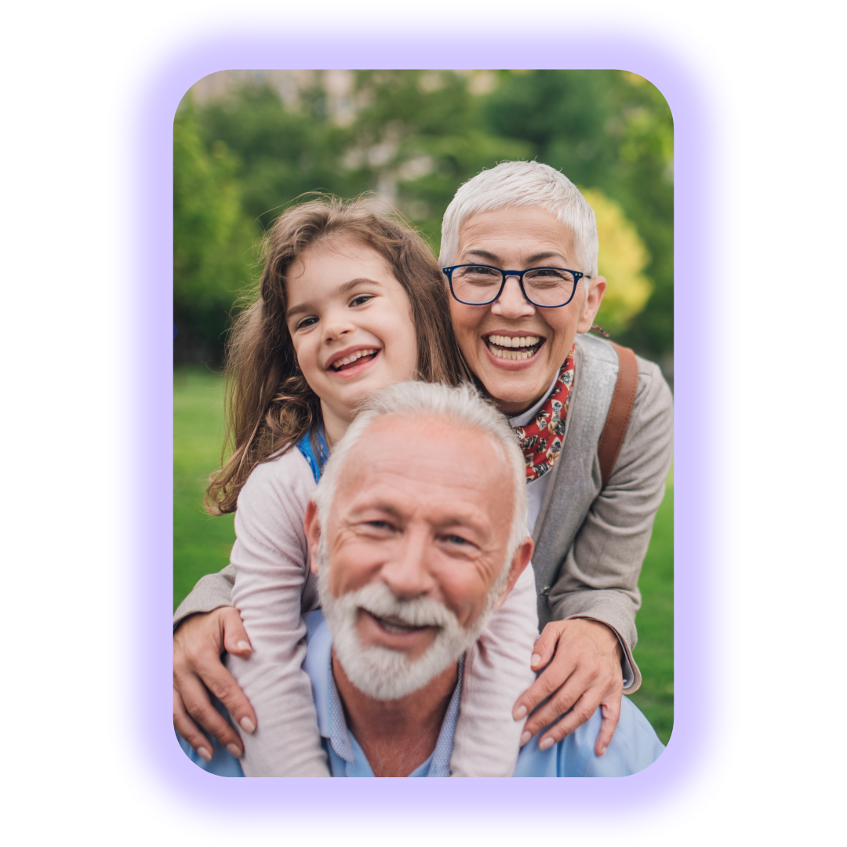
Is this a phase they will grow out of?
Sexual orientation and gender identity are not a choice, or changeable through things like talk therapy or, for faith-based people, praying
The most important thing to communicate is that you love them
Let them guide the conversation
Notes:
LIZ:
While a person’s gender identity, gender expression, and sexual orientation might evolve over time (a process sometimes referred to as questioning), these characteristics are not changeable through things like talk therapy or, for faith-based people, praying. When a young person is in a questioning process and figuring out who they are, the most important thing to communicate is that you love them, that you are grateful to them for letting you know, and that you will be there for them as they discern who they are and whom they love. Let them guide the conversation so that it is not overwhelming to either you or to your loved one.

Slide 11
If I suspect my grandchild is LGBTQ+, should I bring it up first?
Let your loved one lead
Ask gentle, open-ended questions
Support and listen
Notes:
SHERRILL:
We strongly suggest that you let your loved one lead. When they are ready, they will talk to you if they feel it is safe to do so. Whether they want to share their hopes for the future, or a situation that happened in school, the prospect for open discussion is endless. If you have a sense that your grandchild might want to talk, but isn’t doing so on their own, a gentle open-ended question, such as, “How did things go at school today?” can open the door to dialogue. Express your support, don’t push, and really listen when they talk.

Slide 12
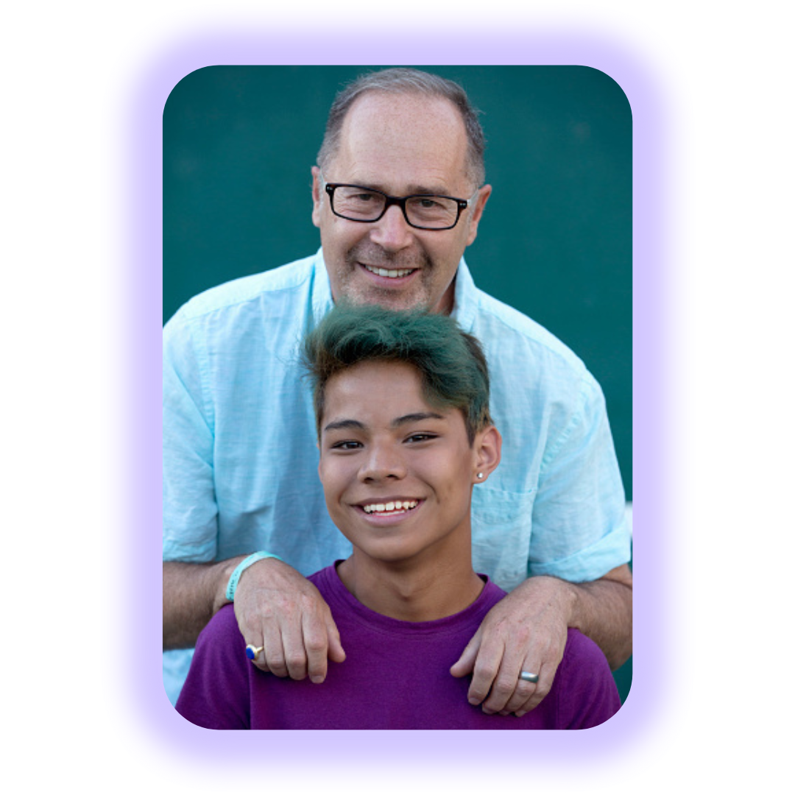
What if I say the wrong thing?
At some point, everyone says the wrong thing…and that’s okay!
Say, “Thank you for telling me that.”
Apologize.
Do better next time…and practice if you need to
Notes:
LIZ:
Let’s set a baseline: At some point, at some time, you are going to say the wrong thing—parents and grandparents always have that moment! It’s okay; you’re human and it happens, and it doesn’t mean you don’t love your grandchild. This is new for you and for them. If you make a misstep in your response—whether accidentally using incorrect pronouns or asking a too-personal question—apologize and work to do better next time; no one is perfect. It is in making the attempt that you show your love and support.

Slide 13
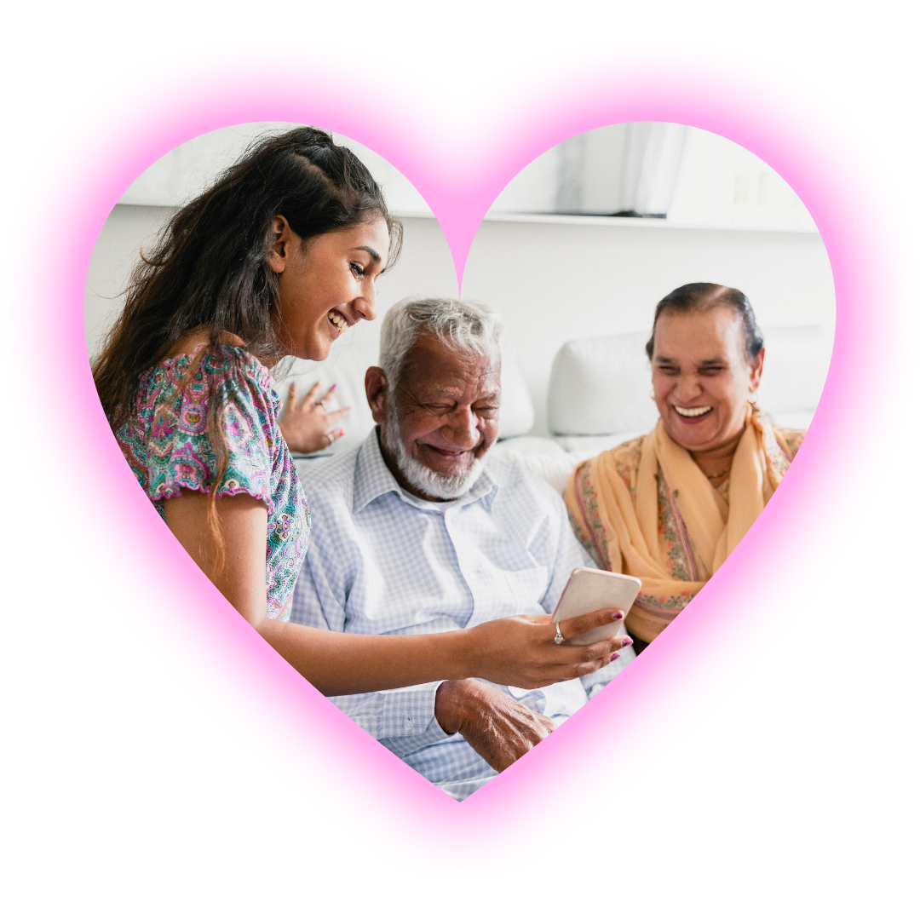
How can I show my support to my loved one?
Lead with love
Find ways to express your support, directly or indirectly
If you are struggling with your feelings, continue to support and find places to take your struggle away from your loved one
Notes:
SHERRILL:
First and foremost, lead with love. Your support can be shown in many ways, from welcoming their LGBTQ+ friends into your home, taking them shopping for that just-right piece of clothing they’ve been asking for, helping provide access to age-appropriate resources, or even just speaking positively about an LGBTQ+ character you saw on television. Showing an interest in their lives, inclusive of their whole selves, is a powerful way to show that you care. And even if you are struggling to understand, you can still support and affirm your grandchild’s identity, and then take your worry to a peer or friend for support. Consider attending a PFLAG meeting (find a local chapter at pflag.org/find) or connecting with a local LGBTQ+ center (visit lgbtcenters.org to find one near you) to get this important support for yourself.

Slide 14
I often hear other people making jokes about LGBTQ+ people. How should I respond?
Be open and direct—with permission, of course
Share your personal story—people might learn from your experience
Notes:
LIZ:
One way to show your grandchild that you have their back is to be open and direct when speaking with others. If you have their permission to be out as a grandparent of an LGBTQ+ person, it is absolutely appropriate (and encouraged) to say something such as, “I have LGBTQ+ relatives and friends and when you make those jokes, it hurts me. I don’t appreciate jokes that make fun of people I love and care about.”

Slide 15
Where can I get additional support?
Supportive friends and family
Supportive organizations, like SAGE and PFLAG
Notes:
SHERRILL:
There is a wealth of information and many supportive people and peers who are here for you.
You can turn to family and friends whom you know will be supportive, you can turn to organizations like SAGE and PFLAG.
SAGE Resources
As a supportive grandparent, you may start to learn of peers who are LGBTQ+ and seeking support. Here are resources to assist older LGBTQ+ friends and family.
Best Practice Guides for Supporting LGBT Older Adults lgbtagingcenter.org/guides
I’m Coming Out: Coming Out as LGBT in Later Life lgbtagingcenter.org/comingoutlater
SAGE National LGBT Elder Hotline sageusa.org/hotline
(SHARE ABOUT SAGE RESOURCES, then PASS TO LIZ)
LIZ:
PFLAG National has nearly 400 chapters across the United States, and has additional resources including publications and online learning opportunities.
PFLAG Publications are at pflag.org/publications
All of PFLAG’s books are available for free download, including
Our Children, which is focused primarily on sexual orientation and offers a fresh eye for families and others about what to do when a loved one comes out;
Our Trans Loved Ones, which is full of information, first-person stories, resources, and expert input geared to those who have a loved one who has come out as transgender; and
Faith in Our Families, which shares personal experiences from families of faith as well as faith leaders from a broad variety of traditions to help those who are working to reconcile their faith with the knowledge that a loved one is LGBTQ+.

Slide 16
pflag.org/YourLGBTQGrandchild

Slide 17
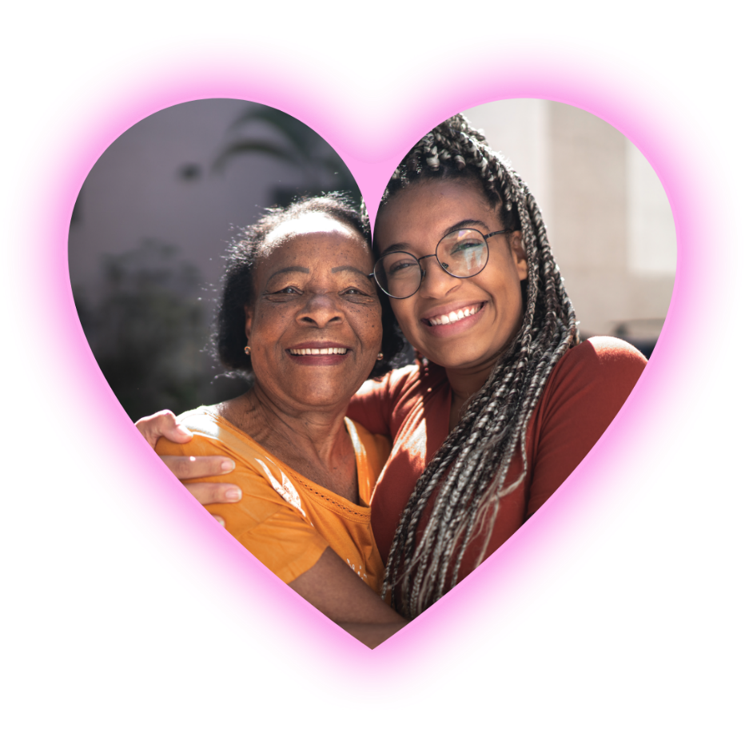
Time for your questions!

